Slide 1
New IP Use cases
Lijun

Slide 2
Part II: Some Examples of New IP Use Cases
Optimal Latency Guarantee for Multiple Concurrent Packets
Qualitative Communication
Information Exchange Oriented Vehicle Clustering
And many more

Slide 3
Statistical Multiplexing to Computational Multiplexing
Statistical multiplexing does not work at a packet level. They do not distinguish among packets on whether they are latency-sensitive or not, thus do not treat the latency-sensitive packets differently.
Compared to statistical multiplexing in the current Internet, a computational multiplexing concept is proposed in New IP.
  For a latency-sensitive packet, the precise location in the outgoing queue based on its time constraint can be computed, such that the scheduling order of all latency-sensitive packets can be determined.
  Computational scheduling takes into consideration of per-packet timing data at a finer granularity as compared to flow-level granularity.
  With computational multiplexing, simultaneously arriving packets on same output ports are scheduled deliberately in order to satisfy their deadlines if they are specified in the packets.

Slide 4
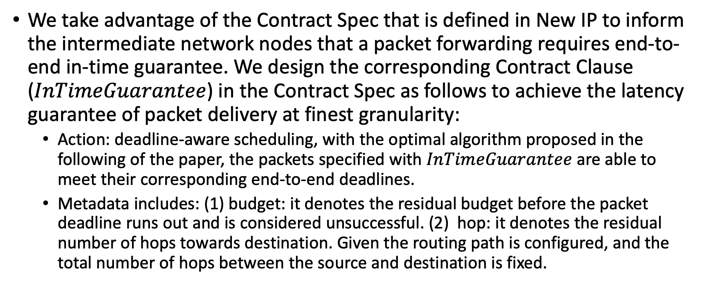
New IP Contract Design
We take advantage of the Contract Spec that is defined in New IP to inform the intermediate network nodes that a packet forwarding requires end-to-end in-time guarantee. We design the corresponding Contract Clause ($InTimeGuarantee$) in the Contract Spec as follows to achieve the latency guarantee of packet delivery at finest granularity:
  Action: deadline-aware scheduling, with the optimal algorithm proposed in the following of the paper, the packets specified with $InTimeGuarantee$ are able to meet their corresponding end-to-end deadlines.
  Metadata includes: (1) budget: it denotes the residual budget before the packet deadline runs out and is considered unsuccessful. (2) hop: it denotes the residual number of hops towards destination. Given the routing path is configured, and the total number of hops between the source and destination is fixed.

Slide 5

Dedicated LGQ for Latency Guaranteed Packets
At each router, there is a dedicated queue for latency guaranteed packets, called latency guarantee queue (LGQ)
All packets forwarded by the router with $InTimeGuarantee$ contract clause are put in LGQ. The packets in LGQ have the highest priority to be scheduled compared to other packets without deadline constraints.

Slide 6
Motivation
From a router’s perspective, it may have more than one packet (multiple packets) that require latency guarantee. The scheduling of those packets matters.
  If FIFO is adopted, some packets in LGQ may miss the deadline.
  The time that a packet spent at a router before it is forwarded to the next hop (called as dwell time)includes
    Processing delay: likely fixed (we do not consider in the document)
    Queueing delay: affected by packet scheduling in LGQ.
    Transmission delay: affected by the size of the packet, proportional to the packet size.
The average dwell time determines averagely how long a packet stays in a router before its last bit gets transmitted completely.
Although previously proposed scheduling policy may be able to satisfy the deadline requirements of the packets, they did not consider how transmission delay affects the scheduling.
A packet scheduling algorithm that adopts the computational multiplexing enabled by New IP could be designed, which considers both the packet transmission delay and deadline requirement, achieve the minimal average dwell time.

Slide 7
Step by Step to Illustrate TDMS
Packets | Deadline | Transmission Time
p1 | 10 | 5
p2 | 14 | 2
p3 | 15 | 1
p4 | 6 | 3
Line 2: sort packets by decremental order of transmission time
Outer loop 1
Outer loop 2
Packets | Deadline | Transmission Time
p1 | 10 | 5
p4 | 6 | 3
p2 | 14 | 2
p3 | 15 | 1
TDMS | Deadline | Transmission Time
p2 | 14 | 2
TDMS | Deadline | Transmission Time
p1 | 10 | 5
p2 | 14 | 2
Total transmission time of set J₁ is 5+3+2+1=11, the last packet in the TDMS schedule must be the packet with the largest transmission time that meets its deadline, which is p2.
Total transmission time of set J₂ is 5+3+1=9, the last packet in the TDMS schedule must be the packet with the largest transmission time that meets its deadline, which is p1.
Outer loop 3
Outer loop 4
TDMS achieves minimal average dwell time, which is (1+4+9+11)/4=25/4=6.25
TDMS | Deadline | Transmission Time
p4 | 6 | 3
p1 | 10 | 5
p2 | 14 | 2
TDMS | Deadline | Transmission Time
p3 | 15 | 1
p4 | 6 | 3
p1 | 10 | 5
p2 | 14 | 2
Total transmission time of set J₃ is 2+1=3, the last packet in the TDMS schedule must be the packet with the largest transmission time that meets its deadline, which is p4.
Total transmission time of set J₄ is 1. The only left packet is p3, which is put in the very front of the queue. Return TDMS.
7

Slide 8


Integrity of Packet
Sender
Receiver
Syntax
What is received What is sent
Every bit and byte has the same significance to routers/switches
Packet
Packet
Good for
File/Document Transfer
Banking, Shopping
Overkill for some applications
Video
Holograms
Packet
Corrupted Packet
8
Icon made by Freepik from www.flaticon.com

Slide 9
Cost of retransmissions due to packet dropping
When reliable transport layer protocol is used, packet drops result in the retransmission of the packet.
Sender
Receiver
Cost of re-transmissions
  Wastes network resources
  Reduces the overall throughput,
  Unpredictable longer delays.
t₀
P₁ sent
t₀
t₁
t₁
RTO for P₁
t₂
Timeout or Dup ACKs (lost segment)
t₂
Retransmit P₁
t₃
t₃

Slide 10
Qualitative Communication: A structure of bits and bytes
Sender
Receiver
Semantics
What is received What is maximally meant
In payload, bits and bytes are not equally significant. Instead, they are different in their entropies
Less significant bits and bytes may be dropped
Partial or degraded, yet useful, packets may be repaired and recovered before being rendered
Good for
Large volume of image-like data
Holographic type communications
Media with digital senses
Disaster Environment

Slide 11
Qualitative Communication: an example for illustration only
User Data Payload: Divided into 8 chunks.
Contract:
Event: Congested OR Radio Unstable
Action: Packet Wash
Meta-Data: Chunk 1, Chunk 2, chunk 6, Chunk 7, Chunk 8
On congested node: after cut
Packet Wash is preferred to drop-and-retransmit

Slide 12
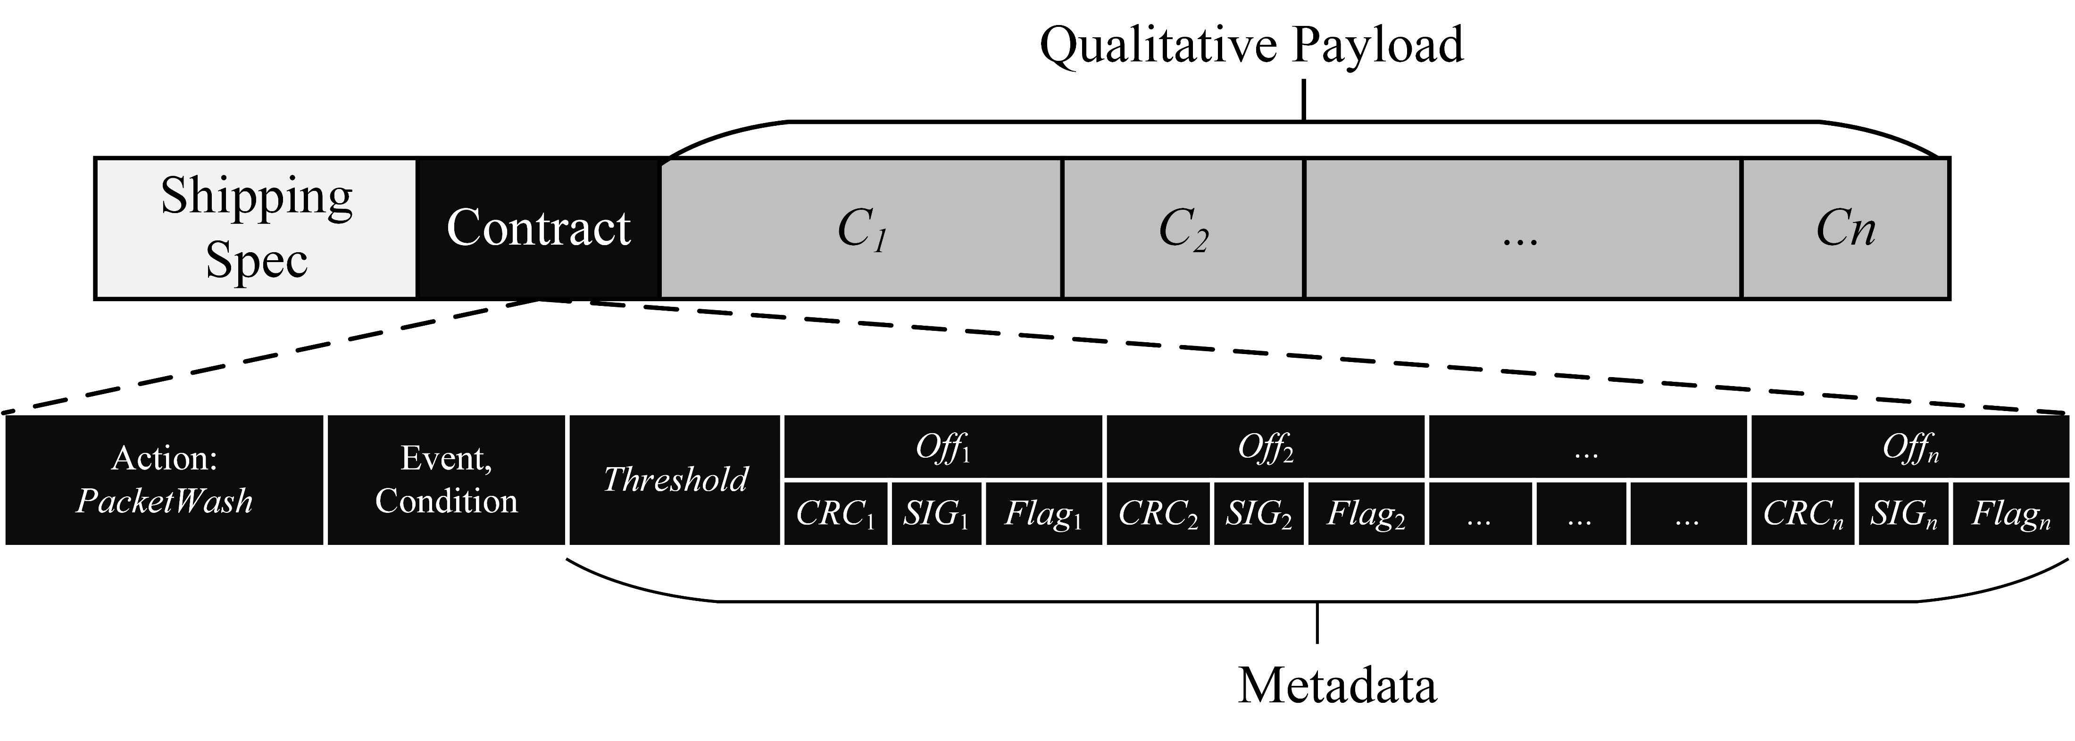
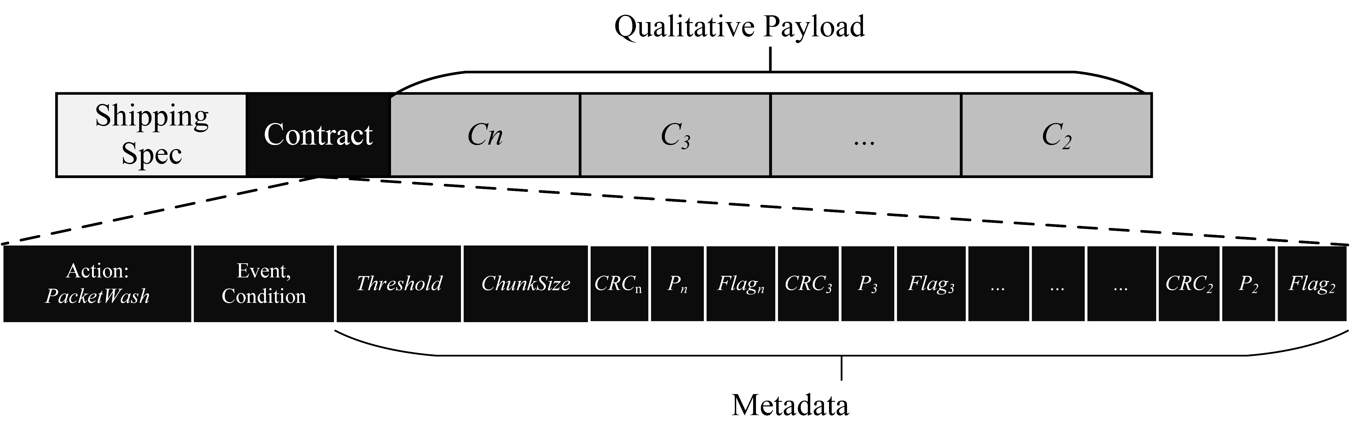
Significance based packetization

Slide 13
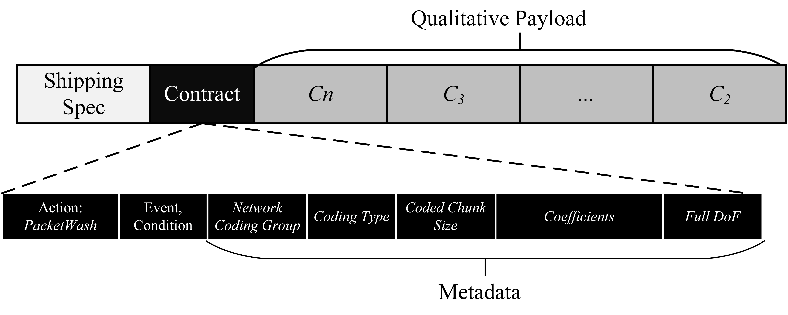
Random Linear Network Coding based packetization

Slide 14
New IP Enables Information Exchange Oriented Vehicle Clustering
Some vehicle may not have access to the infrastructure and needs other vehicle with Wifi or cellular interface to relay its data request to the infrastructure nodes and the data sent from the infrastructure nodes.
An information topic based clustering builds a collaborative vehicular system for information exchange being delegated to those vehicles that have infrastructure access and are willing to provide the service to other neighboring vehicles.
Action: forward to cluster head
Metadata: content identifier, topic name, cluster tag, aggregation permitted
Source: requesting vehicle IP address
Destination: content host IP address (could be set to cluster head IP address)
New IP packet for information request
Metadata: content identifiers, aggregation performed
Source: cluster head IP address
Destination: content host IP address
New IP packet for aggregated requests
Metadata: content identifier, offset in payload for corresponding data.
Source: requesting vehicle IP address
Destination: content host IP address (could be set to cluster head IP address)
New IP packet for concatenated data

Slide 15
References for Future Reading
Lijun Dong, Richard Li, Collaborative Computation in the Network for Remote Driving, IEEE SSCI, 2021.
Lijun Dong, Richard Li, “Distributed Knowledge Inference and Reasoning in the Network Based on New IP,” International Symposium on Networks, Computers and Communications (ISNCC), 2021.
Lijun Dong, Lin Han, “New IP Enabled In-Band Signaling for Accurate Latency Guarantee Service,” IEEE WCNC, 2021.
Lijun Dong, Alex Clemm, “High-Precision End-to-End Latency Guarantees Using Packet Wash,” IFIP/IEEE International Symposium on Integrated Network Management (IM), 2021.
Lijun Dong, Richard Li, “Optimal Chunk Caching in Network Coding Based Qualitative Communication,” Journal of Digital Communications and Networks, available online, June 2021.
Richard Li, Uma S. Chunduri, Alexander Clemm and Lijun Dong, “New IP: Enabling the Next Wave of Networking Innovation,” book chapter in “Design Innovation and Network Architecture for the Future Internet”, pp 1-42, DOI:10.4018/978-1-7998-7646-5.ch001, Jan 2021.
Lin Han, Lijun Dong, Richard Li, “A Study of In-Vehicle-Network by New IP,” The Thirteenth International Conference on Evolving Internet, 2021.
Lijun Dong, Kiran Makhijani, Richard Li, “Qualitative Communication Via Network Coding and New IP,” IEEE HPSR 2020.
Lijun Dong, Richard Li, “Scheduling of Complex Computation Offloading Tasks in Mobile Edge Cloud Network with New IP Framework,” IEEE World Forum on Internet of Things 2020.
Lijun Dong, Richard Li, “Packet Level In-Time Guarantee: Algorithm and Theorems,” IEEE Globecom 2020.
Lijun Dong, Richard Li, “Enhance Knowledge Inference and Reasoning by New IP,” IEEE iThings 2020.
Lijun Dong, Richard Li, “Semantics and Deviation Aware Content Request,” IEEE ISCC 2019.
Lijun Dong, Richard Li, “Information Exchange Oriented Clustering for Collaborative Vehicular System,” IEEE WOCC 2018

